Slide 1
ICP

Slide 2
Glossary
ICP – Inter Carrier Porting – This is a process which enables wireless carriers to port numbers amongst themselves.
WPR – Wireless Port Request – The Transaction from a New Service Provider to an Old Service Provider
WPRR – Wireless Port Request Response – The Transaction from an Old Service Provider to a New Service provider
WICIS – Wireless Intercarrier Communications Interface Specifications – The specification which guides the electronic bonding between carriers.

Slide 3
TWO STEP PROCESS
ICP
    Wireless Providers must reach an agreement amongst themselves that a particular Telephone number can be ported over and the ICP will allow the trading partners to communicate with each other before the actual switch can be done at NPAC.
    Transactions : WPR and WPRR
SOA
    Wireless Providers must exchange messages with NPAC about the porting request and the SOA process will allow the trading partners to make the final transfer of number.
    Transactions : Create Sv, Modify Sv, Disconnect Sv, Activate Sv

Slide 4
ICP Basics
Telephone Number, Customer Account Number/SSN, Customer Name and Due Date are some of the primary fields in a WPR.
The Due Date on the WPR needs to be at least 2.5 hours out in the future.
OSP needs to respond with a WPRR within 30 minutes of the receipt of the WPR.
A WPRR can contain the following response types
  “C” – Confirmation – Give away the number
  “R” – Resolution Required – Information is incorrect in the WPR – Correct and Resend
  “D” – Delay – Need additional time to look at the WPR

Slide 5
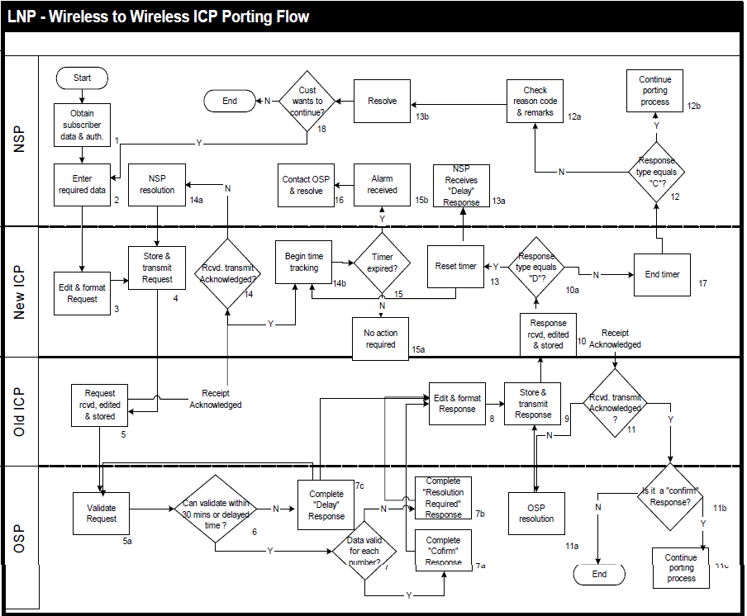

Slide 6
#1 : ICP Only – Sunny Day
  NSP sends a WPR to the OSP with the intent to port a number
  OSP returns a WPRR of type “C” indicating a Confirmation
CLEC
ILEC
WPR
Client
Server
DB
DB
WPRR/C
Server
Client

Slide 7
#2 : ICP Only - Rainy Day
  NSP sends a WPR to the OSP with the intent to port a number
  OSP returns a WPRR with “R” – a Resolution Required Response - indicating the reason that the number cannot be ported for such an such reason
  NSP sends a Supplement WPR after providing the information requested by OSP.
  OSP returns a WPRR with a “C” response
CLEC
ILEC
WPR
Client
Server
WPR(Supp)
DB
DB
WPRR/R
Server
Client
WPRR/C(Supp)

Slide 8
#3 : ICP Only - Rainy Day
  NSP sends a WPR to the OSP with the intent to port a number
  OSP Sends a WPRR back with a “D” – a Delay type of response - indicating that they are unable to process the request the request at this time.
  OSP eventually needs to return either a “R” or a “C” response
CLEC
ILEC
WPR
Client
Server
DB
DB
WPRR/D
Server
Client
WPRR/R/C

Slide 9
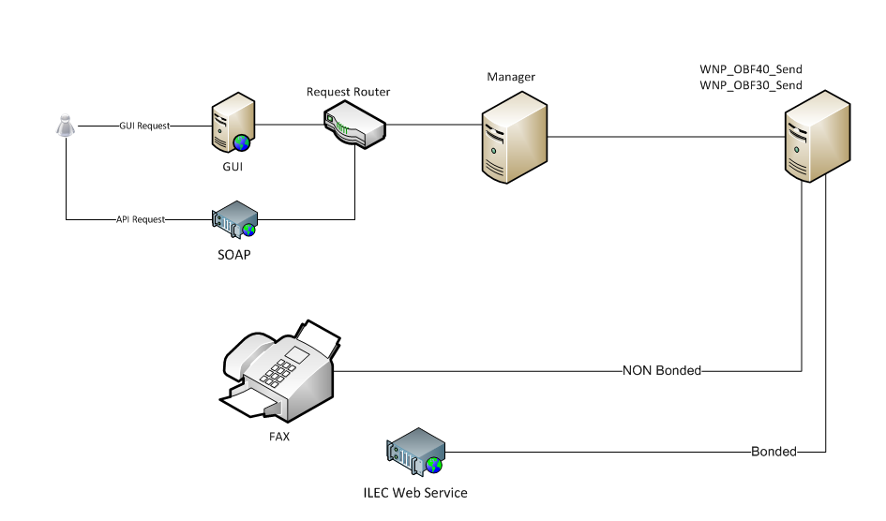
ICP Send Flow

Slide 10
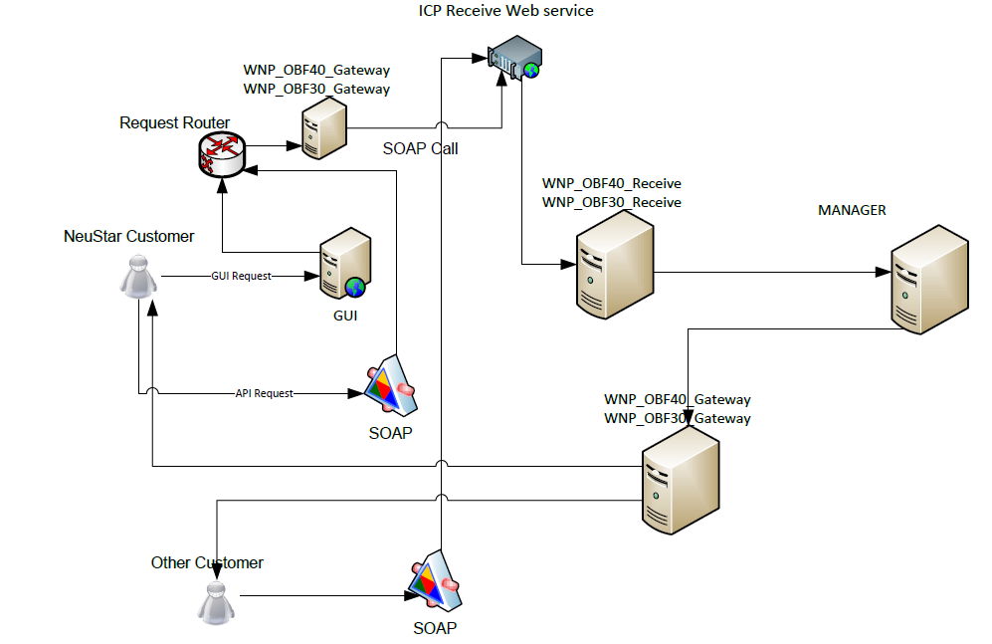
ICP Receive Flow

Slide 11
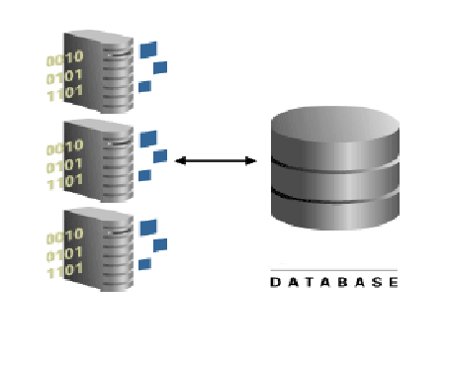
DATA BASE
MANAGER
GATEWAY

Slide 12
WNP Database
For WNP- tables that are logged to with each transaction
Manager logging tables are (manager database)
SVC_COMPONENT [ BOID --> BOID.XML ]
MGR_SVC_BUNDLE [ BOID --> BOID.XML ]
WNP_MGR_ICP_PORT_IN [ BOID --> NF.XML ]
Gateway logging tables are (Gateway database)
WIRELESS_NPORT_MESSAGE [ REQUESTNUMBER --> NF.XML ]
WIRELESS_UOM_MESSAGE [ CORRELATIONID --> UOM ]
ICP_MESSAGE_Q [ MESSAGEKEY {Multiport Response} --> UOM ]

Slide 13
INTERMODAL Database
Manager logging tables are (manager database):
MGR_INTERMODAL_WPR_MESSAGE [ BOID]
MGR_INTERMODAL_WPR_ORDER [ BOID]
MGR_INTERMODAL_LSR_ORDER [TXNUM]
MGR_INTERMODAL_PREORDER [REQUESTNUMBER]
Gateway logging tables are(Gateway database)
WIRELESS_NPORT_MESSAGE
LSR_MESSAGE
EDILSR_MESSAGE_Q
EDICSR_MESSAGE_Q
EDIAV_MESSAGE_Q

